Slide 1
Design Reference
By Lilly :)
Figma : https://www.figma.com/file/g2cx3G9jRbyU2KKppum6zc/ICN-Design-Suggestion?node-id=0%3A1

Slide 2
Main Page

Slide 3

1. main page – section 1 (Yanolja)
https://careers.yanolja.co/
I like the way an image fits fully to the screen when I enter this site. It would be nice if banner slides go here as well.

Slide 4
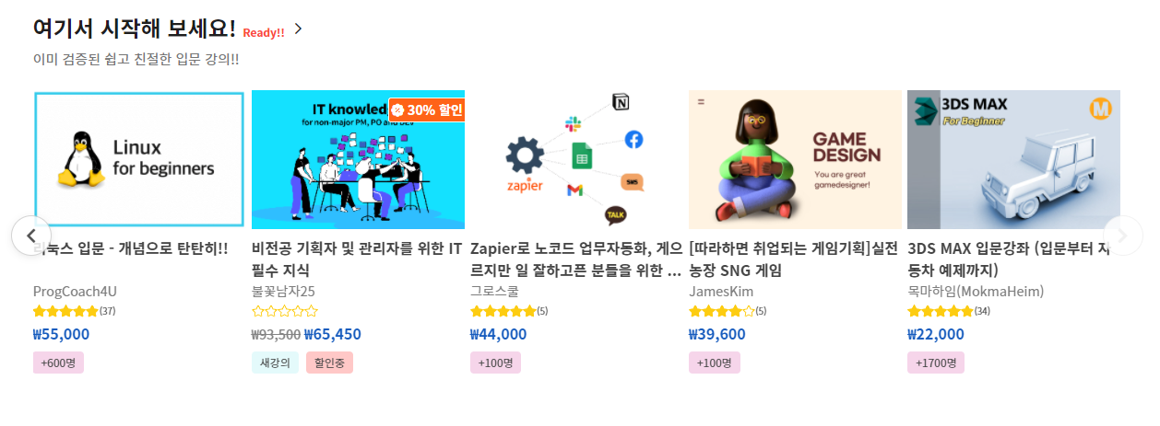
2. main page – section 2 (Inflearn Promotion)
https://www.inflearn.com/
This slide holds lectures those are on discount, it contains information about prices before and after the discount and the rate of the lecture.

Slide 5
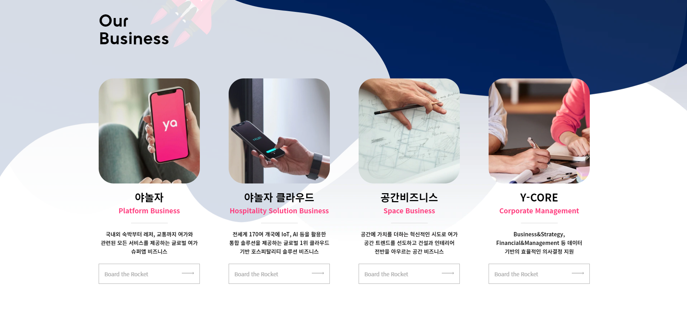
3. main page – section 3 (Yanolja)
https://careers.yanolja.co/
Image of the lecture
Lecture description
Link to the detail page
This section’s layout can contain preview of Highlights of ICN lecture or recommend tutors and links to the detail pages.

Slide 6

4. main page – section 4 (Yanolj)
https://careers.yanolja.co/
This section can hold links to the page where lecture list categorized by subject.
Replace Y-Career, Tech Blog, Y-Life to ESL, Business, Marketing, etc..
When you hover each of them, the bubble shows short description of the subject and when you click on it, it leads to the page relevant to the subject.

Slide 7
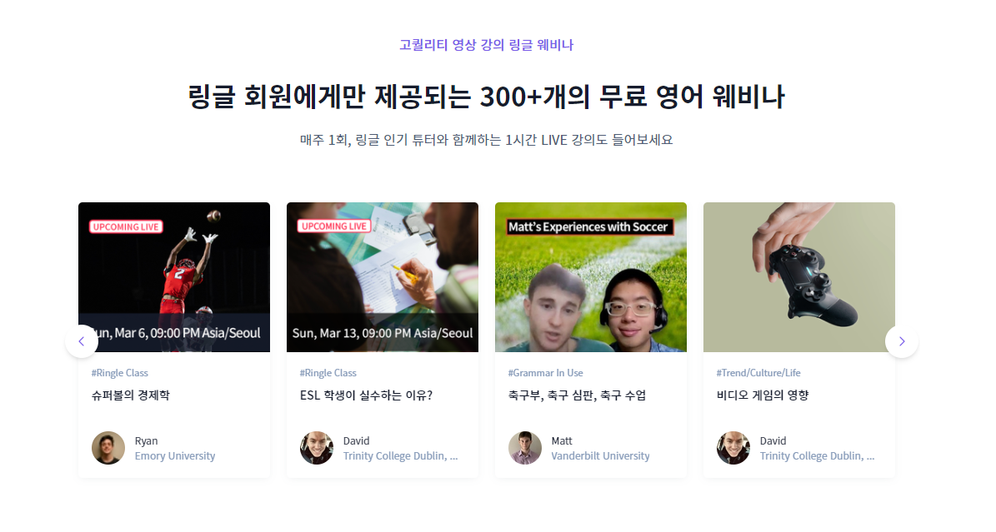
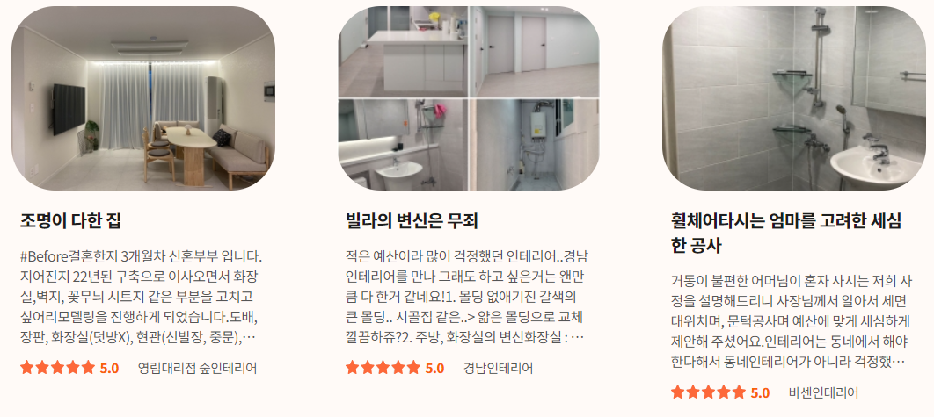
5. main page – section 5 (Ringle review)
https://www.ringleplus.com/ko/student/landing/home
Students’ reviews layout idea!
If there is enough reviews, ringle’s sliding layout seems nice.

Slide 8


6. main page – section 6 (Yanolj)
https://careers.yanolja.co/
To top button
Link to reservation page
It would be nice if there are buttons here and there on the website that lead to the reservation page. So users can easily purchase lectures whatever they want to take.

Slide 9
Header Ideas

Slide 10
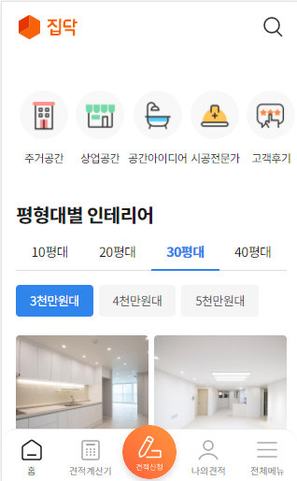
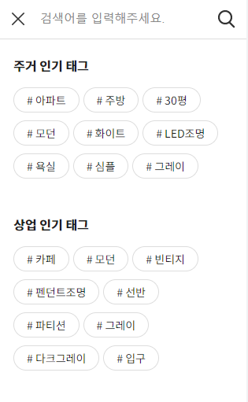
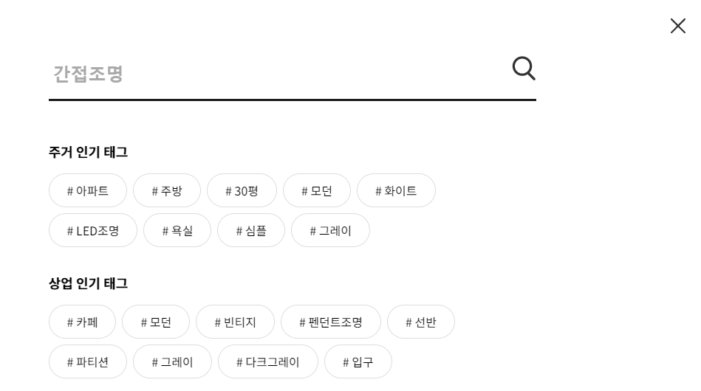
1. Zipdoc Header
Reservation page
https://zipdoc.co.kr/
This site’s header has search icon. Click on it, search area slides down.
Also it has button leading to reservation page.
It also has mobile view, so you can check mobile version of header as well.
Reservation page

Slide 11

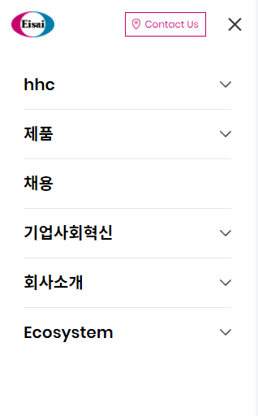
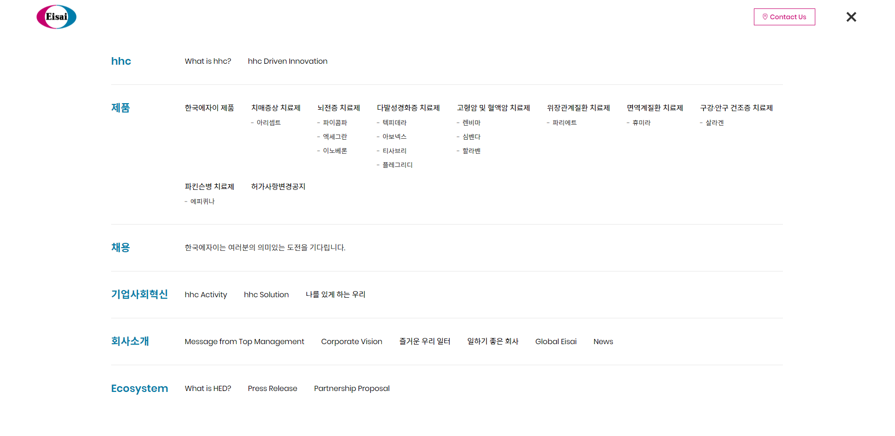
1. esiaikorea Header
https://www.eisaikorea.com/#sec1
This header has hamburger button when you click on it, it shows sitemap.

Slide 12


+ esiaikorea subpage banner
https://www.eisaikorea.com/hhc/what_hhc.php
I also like the subpage main design of this site.

Slide 13
Detail Page

Slide 14
Lecture List Page Ideas

Slide 15
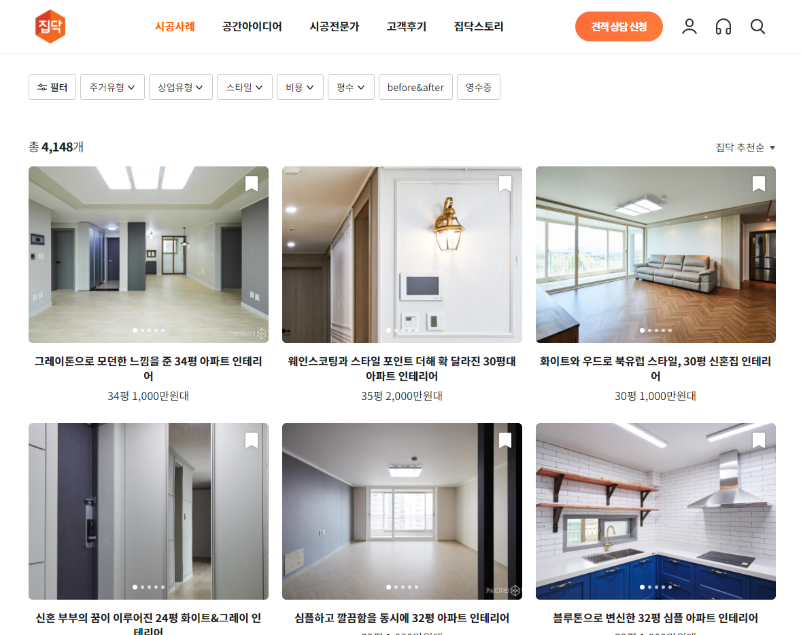
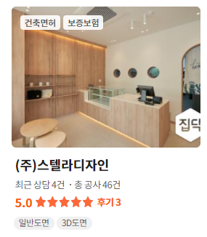
1. Zipdoc keyword search page
https://zipdoc.co.kr/product/construction/list
2. Filter button
This web page layout looks useful for showing large amount of data with images and description together. There can be rate information as well.
2. If you click on the filter button above the page, the modal window appears and whenever you click on the tags, information changes. We can filter out lectures by tutors, times, contents, etc…

Slide 16
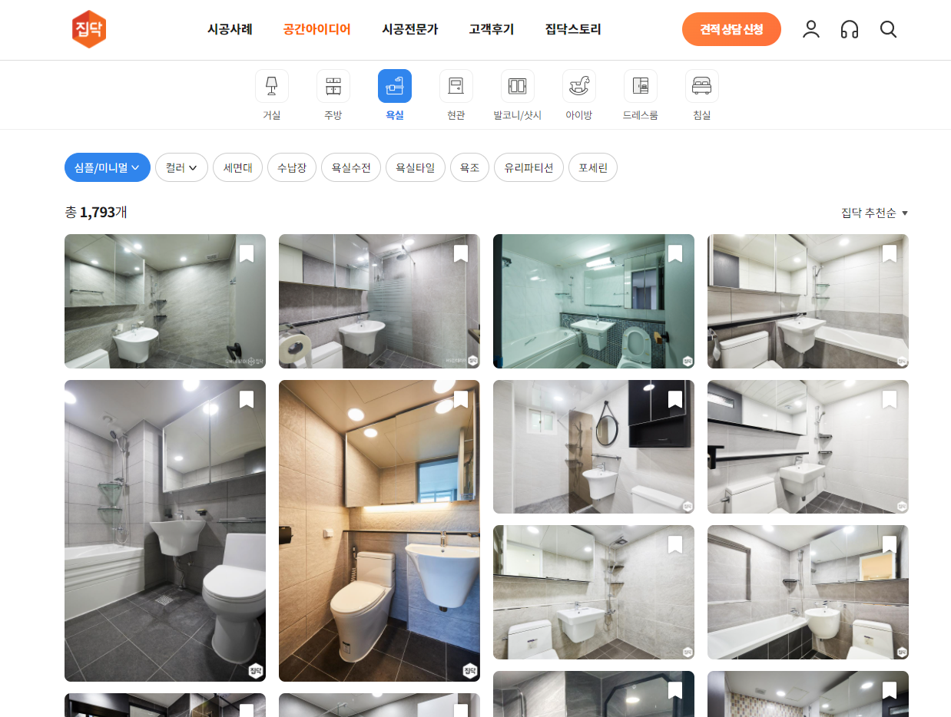
2. Zipdoc keyword search page
https://zipdoc.co.kr/product/construction/list
Another list layout idea!
This has different sizes of images and when you click on the icons the result changes right away.

Slide 17
Lecture detail Page
Page Ideas

Slide 18
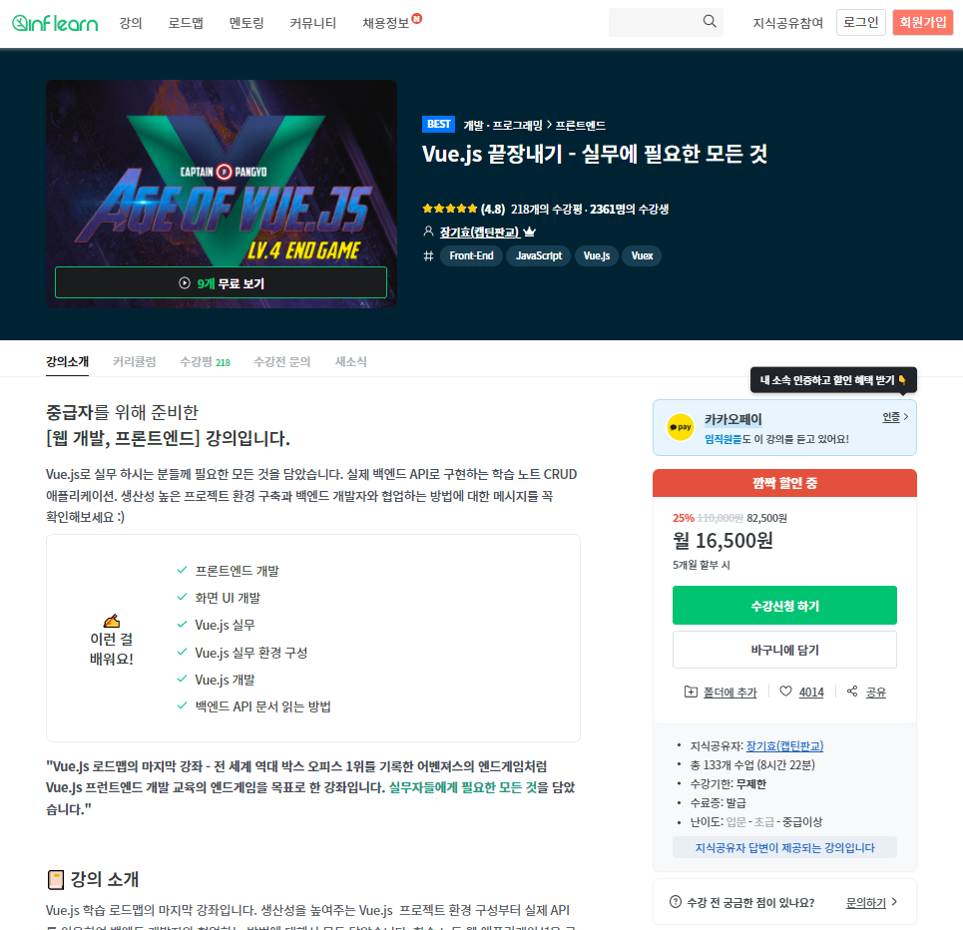
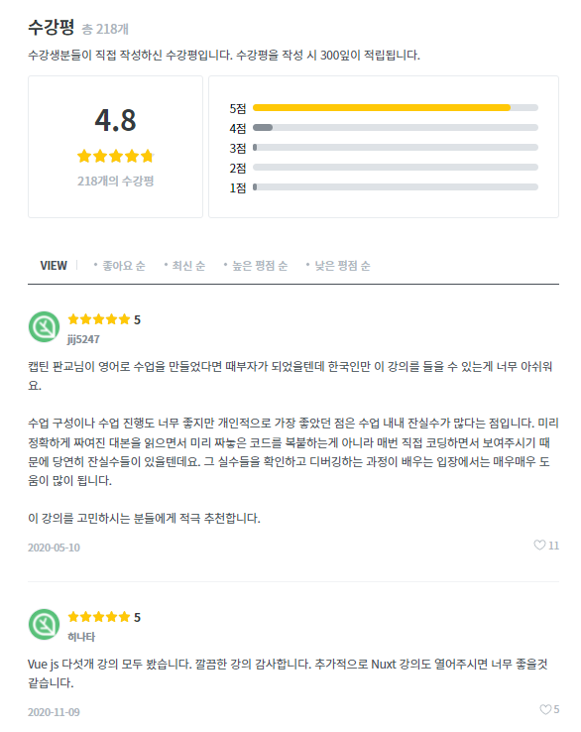
1. inflearn lecture detail page
https://www.inflearn.com/course/vue-js-%EB%81%9D%EB%82%B4%EA%B8%B0-%EC%BA%A1%ED%8B%B4%ED%8C%90%EA%B5%90#curriculum
What I like about this page’s layout is that it shows every detail of the lecture and the right part of contents follows as you scroll down which make user easy to purchase the lecture.
Also at the bottom, there are reviews from the previous viewers.

Slide 19
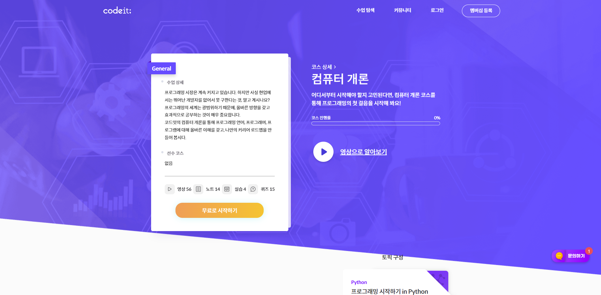
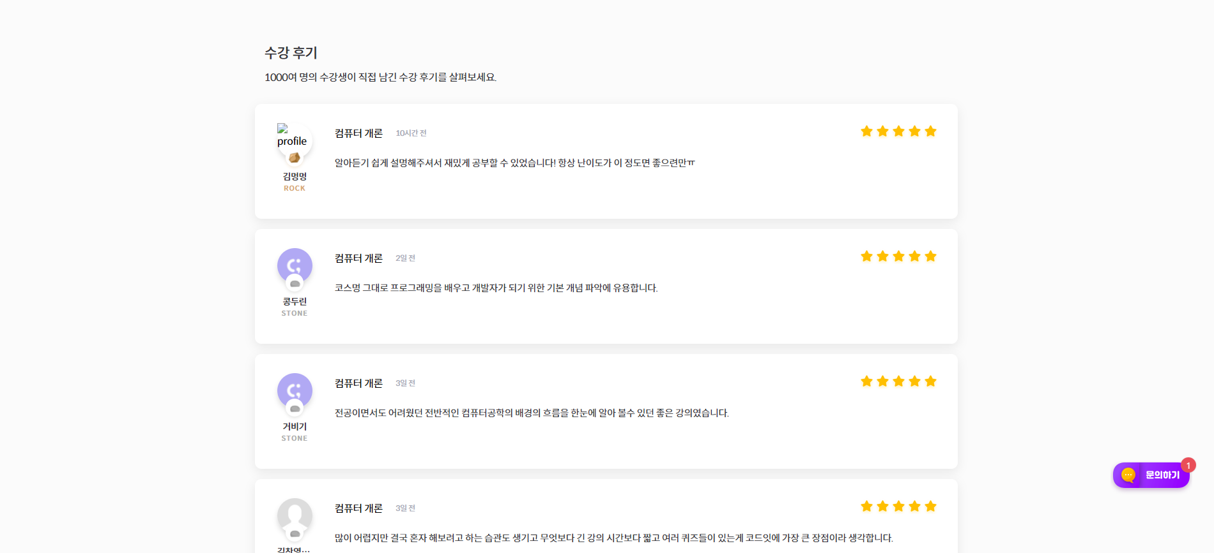
2. codeit lecture detail page
https://www.codeit.kr/courses/11
This site has similar layout but contains less information.

Slide 20
Lecture Reservation
Page Ideas

Slide 21
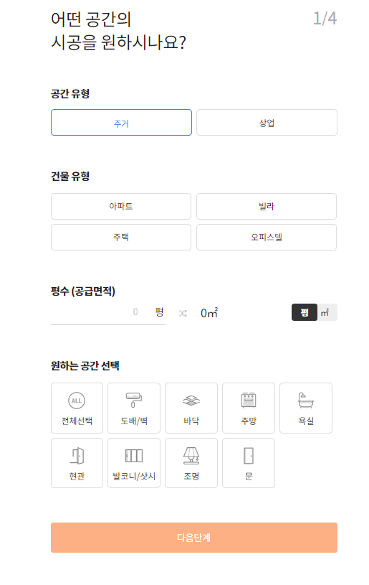
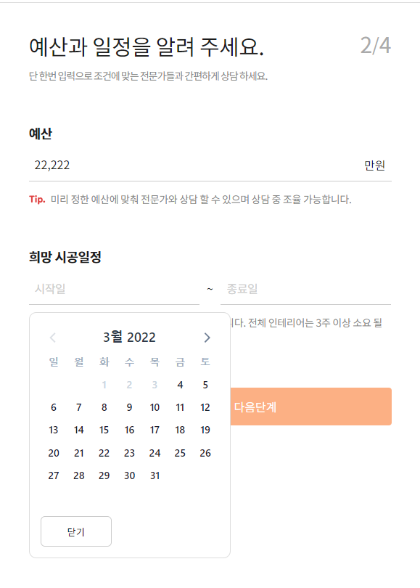
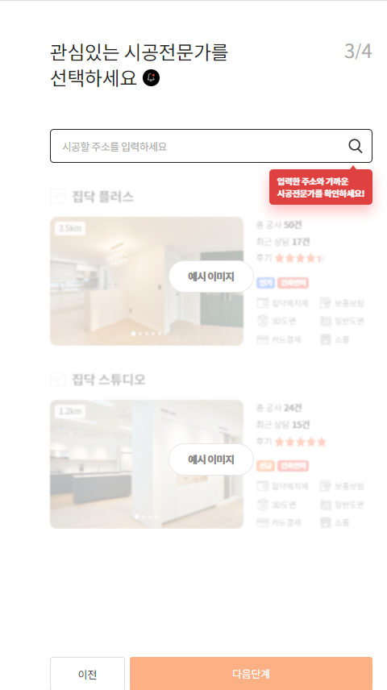
1. Zipdoc Reservation page
https://zipdoc.co.kr/est-e/simple?category_code1=10
Type of lecture
Select Time
Select tutor
This page collects information needed for reservation step by step. Each steps has previous step, next step buttons and information saved respectively.

Slide 22
Lecture Note/Chat Page
Page Ideas

Slide 23
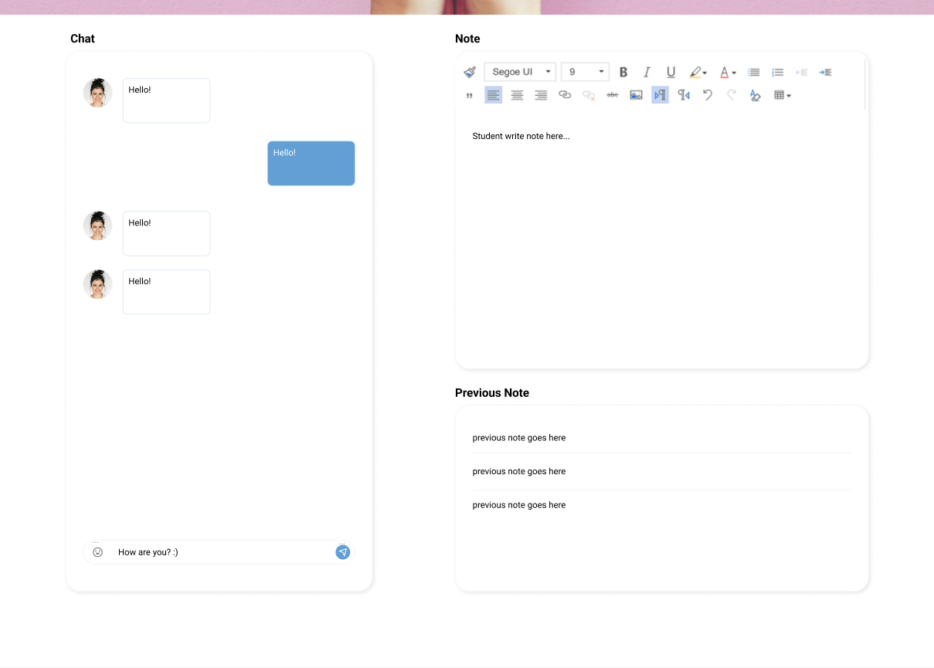
Figma
https://www.figma.com/file/g2cx3G9jRbyU2KKppum6zc/ICN-Design-Suggestion?node-id=0%3A1
It is hard to find good example of lecture note so I made a simple design but this is just one of suggestions.
Left side of the page is for chatting with tutor and on the right side, there can be editor for lecture notes and list of them.

Slide 24
Overall Design Suggestions

Slide 25

1. Garolim
https://garolim.net/main/

Slide 26
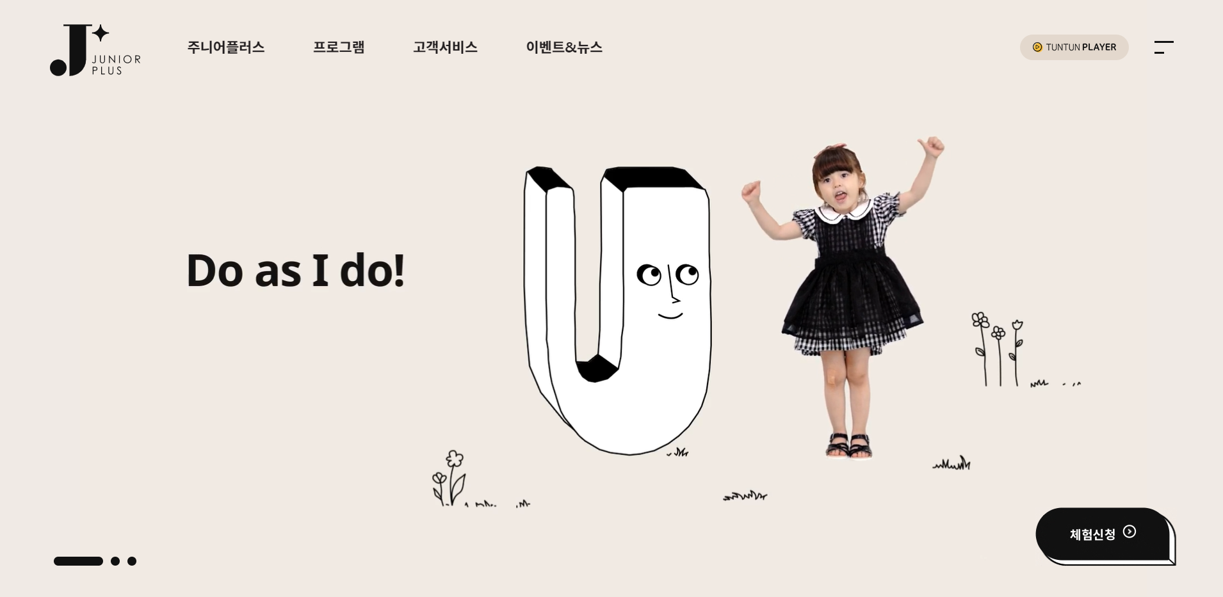
2. juniorplus
https://juniorplus.tuntun.com/

Slide 27
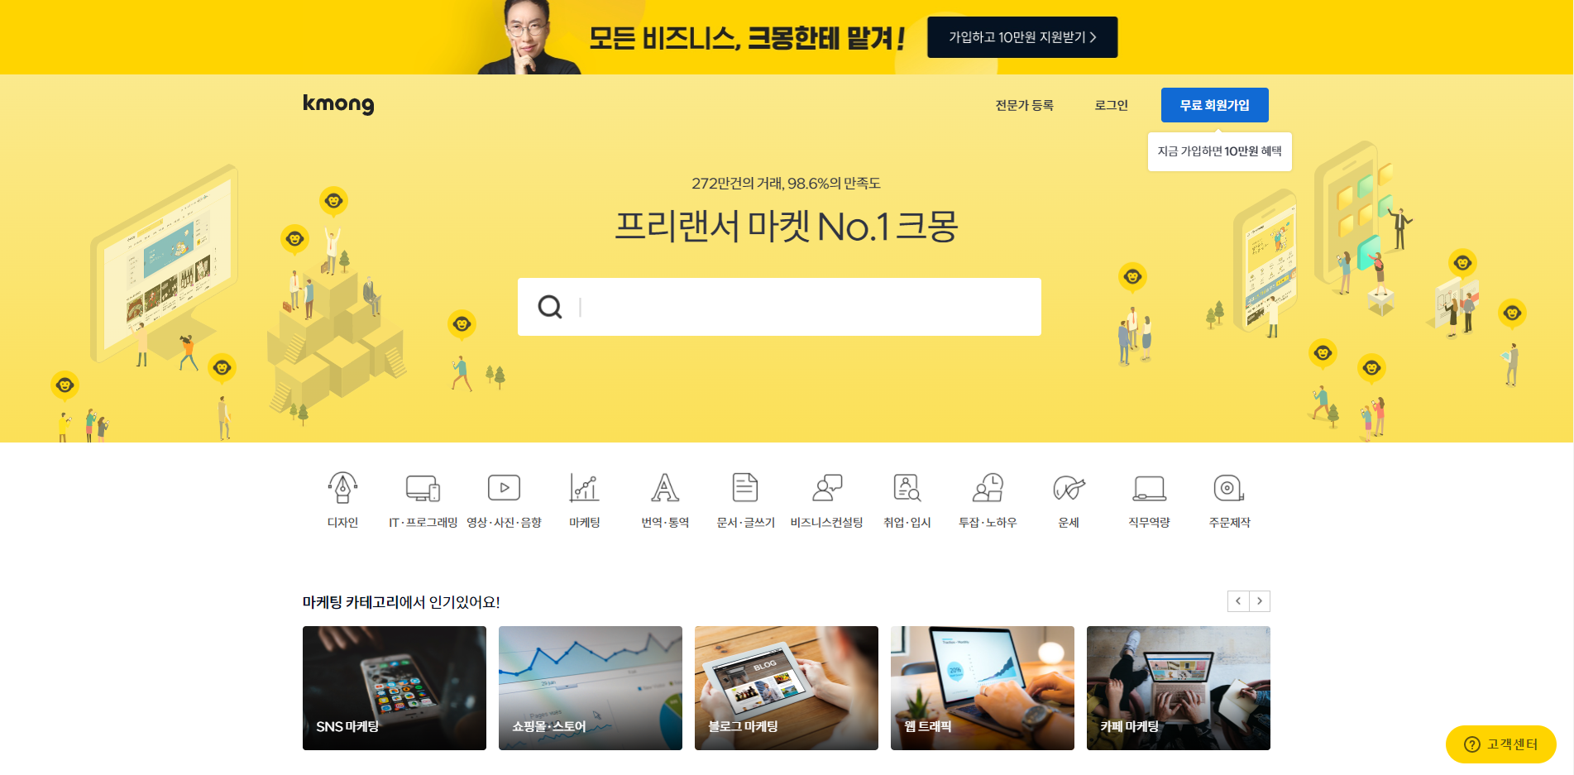
3. kmong
https://kmong.com/

Slide 28
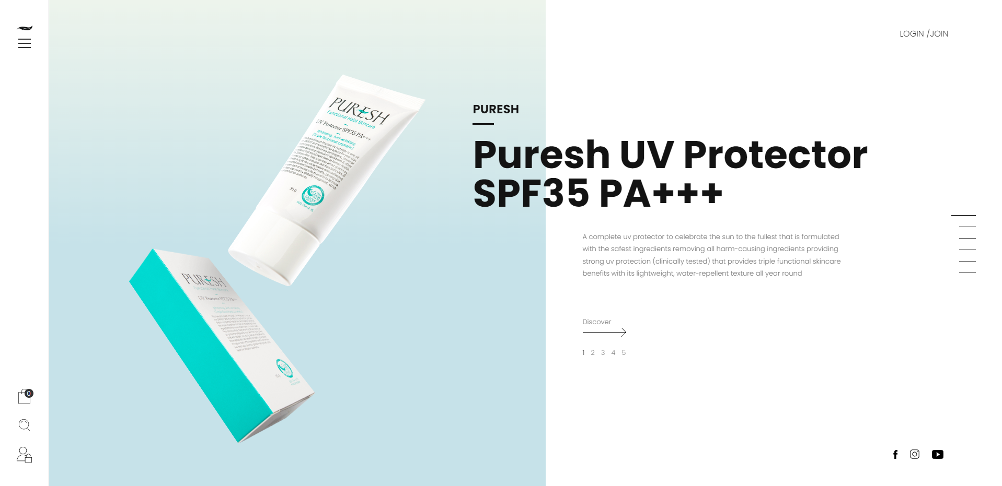
4. puresh
http://cjcasa486108424.godomall.com/us/main/index.php

